Slide 1
Design Patterns
MAS Foundations Course WS-19
Hochschule Bonn-Rhein-Sieg
Lokesh Veeramacheneni

Slide 2
Outline
What are Design Patterns?
Strategy Pattern
Decorator Pattern
Singleton Pattern
Hochschule Bonn-Rhein-Sieg

Slide 3
Design Pattern
Design Patterns are used to represent the flow used by developers for the development of a particular software.
Why Design Patterns ?
Design Patterns describe about
Solution to the problem.
When and where to apply that solution.
Consequences of applying that solution.
Hochschule Bonn-Rhein-Sieg

Slide 4
Design Patterns (cont’d)
Design Patterns are independent of language of implementation.
Types of Design Patterns:
Creational Design Patterns - more concern on the way of object creation.
Structural Design Patterns - gives importance on relations between the classes and simplifying the structure
Behavioral Patterns - concern on the interaction of objects and their responsibilities.
Some Design Patterns:
Singleton
Factory
Prototype
Decorator
Flyweight, etc...
Hochschule Bonn-Rhein-Sieg

Slide 5
Strategy Pattern
Behavioral Pattern
It enables the user to use different algorithms for a particular task.
Also known as Policy.
Advantage is ease of incorporation of new behaviours into the existing code.
Hochschule Bonn-Rhein-Sieg

Slide 6
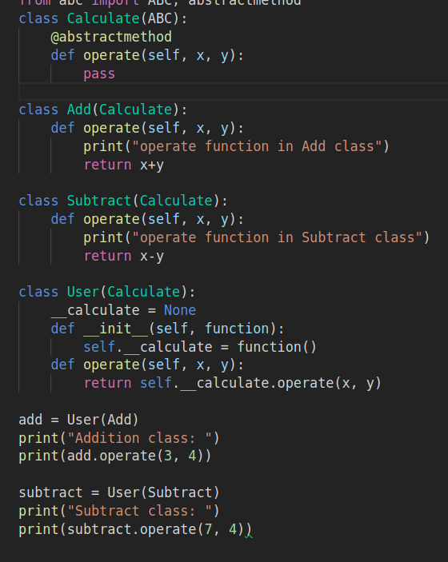
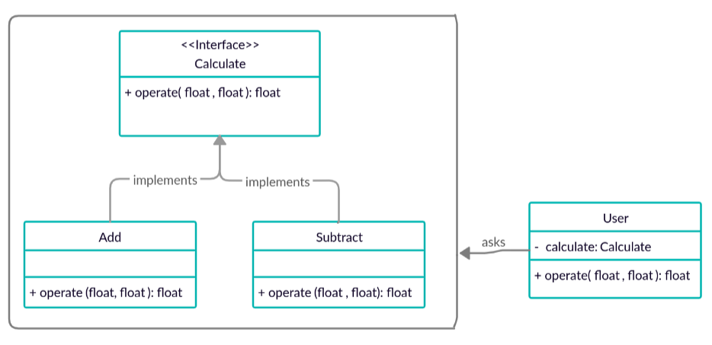
Strategy Pattern (cont’d)
UML Diagram:
Hochschule Bonn-Rhein-Sieg

Slide 7
Decorator Pattern
Structural Pattern
It is used in the scenarios where the object is added with extra responsibilities dynamically.
For example let object is used to make Ice Cream an additional seasoning is added as decorator for that object.
Also called as Wrapper.
Hochschule Bonn-Rhein-Sieg

Slide 8
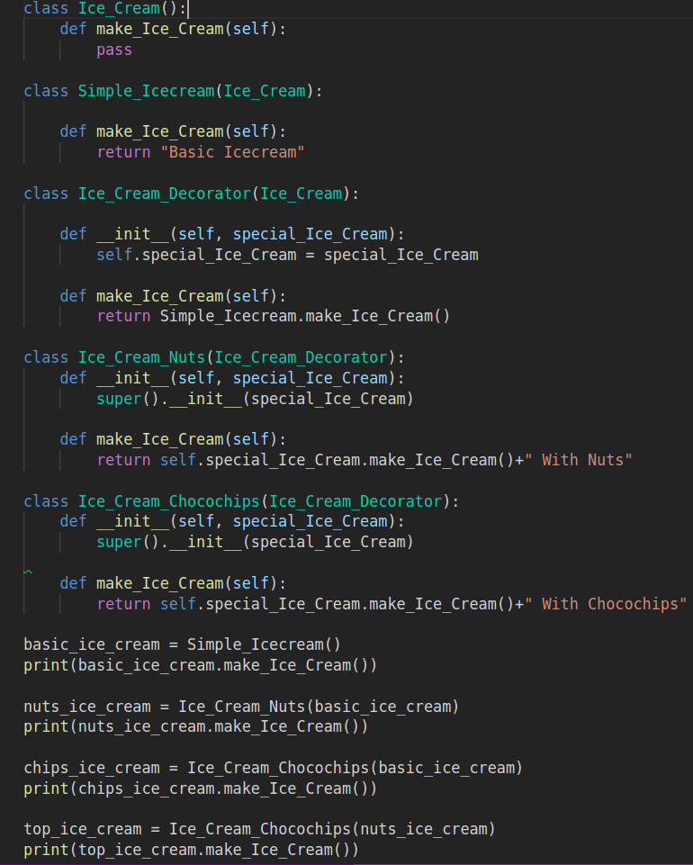
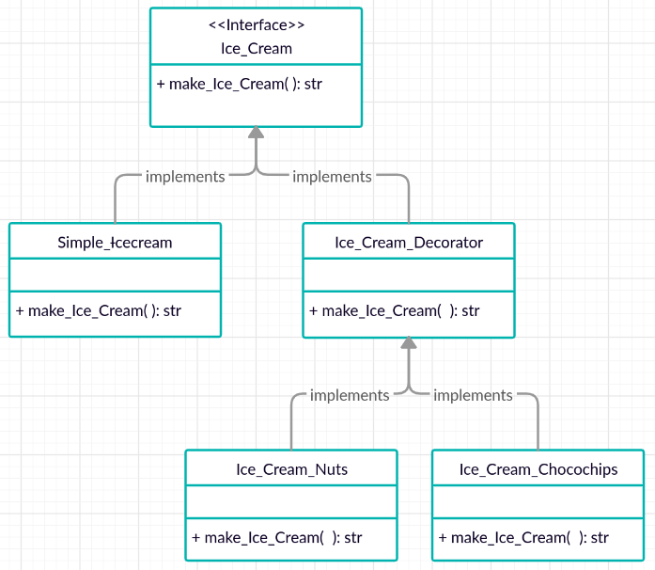
Decorator Pattern (cont’d)
UML Diagram:
Hochschule Bonn-Rhein-Sieg

Slide 9
Singleton Pattern
Creational Pattern
This pattern allows the single instance of the class and this instance acts as global access point.
This pattern is used when memory requirements are strict and it widely used in multi-threading and database applications such as logging, caching, etc.
Based on time of creation of instance , Singleton Pattern can be divided into two forms:
Early Instantiation: Instances are created at time of loading.
Lazy Instantiation: Instances are created when required.
Hochschule Bonn-Rhein-Sieg

Slide 10
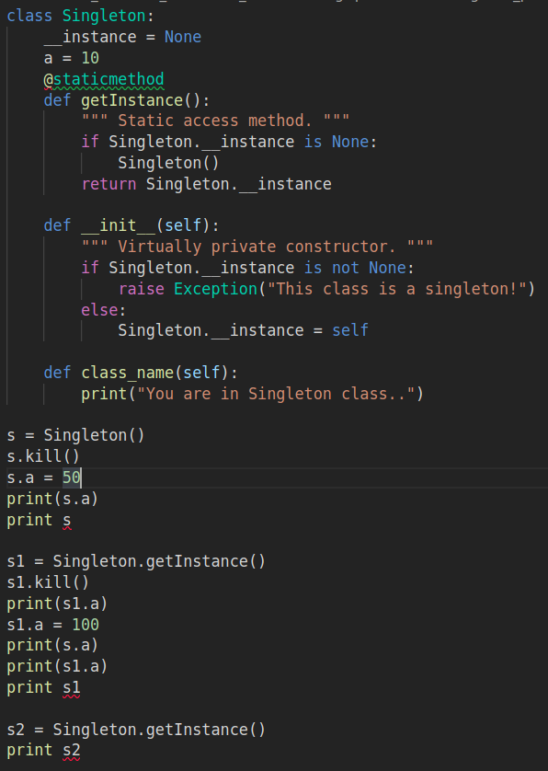
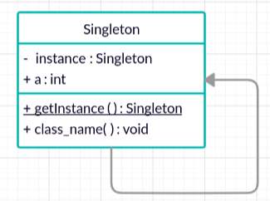
Singleton Pattern (cont’d)
UML Diagram:
Hochschule Bonn-Rhein-Sieg

Slide 11
References:
Learn Design Patterns for absolute beginners - tutorialspoint
Design Patterns in Java - Javatpoint.
Design Patterns - Christopher Okhravi.
Hochschule Bonn-Rhein-Sieg

